Slide 1
Introduction to Data Science
BS DATA SCIENCE
What Is Data Science?
Raw Data → Evidence → Insight → Decision
W01-S01 · Introduction to Data Science
Notes:
Guide W01-S01. Arrive early, put this up, and open with the next slide immediately. No definitions yet.

Slide 2
What do you notice?
Customer | Age | City | Purchases | Income
A | 21 | Karachi | 4 | 80,000
B | 24 | Lahore | 7 | 95,000
C | -5 | Karachi | 3 | 70,000
D | 999 | Karachi | 8 | 110,000
E | 25 | karachi | ? | 120,000
No definitions. For ten minutes, behave like a Data Scientist.
Any Questions about this dataset? List them.
W01-S02 · Introduction to Data Science
Notes:
Guide W01-S02. Say the prompt, then stay quiet. Do not correct anyone yet. Watch whether students spot quality issues, jump to averages, or ask where the data came from.

Slide 3
Data Science turns raw data into decisions
A reasoning process for getting evidence, insight and decisions out of recorded observations. The data comes in three shapes.
Structured
Semi-structured
Unstructured
Rows and columns
Tagged, nested
No fixed layout
ID | Age | Salary | City
JSON: id, name, skills
Text, images, audio, video
W01-S03 · Introduction to Data Science
Notes:
Guide W01-S03. Data is recorded observations: Age = 24, Temperature = 32.5C, City = Karachi, a review, an image. Ask which of the three shapes the messy table was.

Slide 4
Six neighbouring fields
Field | What it does
Data Science
Statistics
Data Analytics
Machine Learning
AI
Data Engineering
Uses data, programming, statistics, and modeling to discover insights and solve problems.
Helps us understand data, measure uncertainty, and draw conclusions using mathematical methods.
Examines data to understand what happened, why it happened, and what actions we should take.
Enables computers to learn patterns from data and use them to make predictions or decisions.
Develops systems that perform tasks associated with human intelligence, such as reasoning, understanding language, and solving problems.
Builds systems and pipelines that collect, transform, store, and deliver reliable data for analysis and applications.
W01-S04 · Introduction to Data Science
Notes:
Guide W01-S04. Fields overlap; these labels describe emphasis, not walls.

Slide 5
One company, five different questions
Scenario: A company has millions of orders from customers.
Data Engineering
Analytics
Statistics
How do we store and process millions of orders reliably?
Which products sold most last month?
Is this group difference likely real beyond our sample?
Machine Learning
Data Science
Which customer is likely to stop buying next month?
How do we use all of this to understand and improve retention?
W01-S05 · Introduction to Data Science
Notes:
Guide W01-S05. Read each question aloud and let students name the field before revealing the card.

Slide 6
The lifecycle: ML is one box of twelve
1
2
3
4
Problem
Question
Data
Quality
5
6
7
8
Cleaning
EDA
Analysis
Visualization
9
10
11
12
ML, if needed
Evaluation
Communication
Decision
At every arrow, what could go wrong here?
W01-S06 · Introduction to Data Science
Notes:
Guide W01-S06. Draw the lifecycle on the board first, then reveal this slide. Ask where Machine Learning is. At each arrow, collect one thing that could go wrong.

Slide 7
10 million rows of unreliable data, or 10,000 trustworthy rows?
Think. Pair. Share. Then: better for what?
Volume does not equal quality.
W01-S07 · Introduction to Data Science
Notes:
Guide W01-S07. Give 2 minutes of think-pair-share. If someone says 10 million, ask: better for what?

Slide 8
The Data Scientist's Seven Questions
Where did this data come from?
What does one row represent?
What does each column actually mean?
Can I trust this data?
What is missing, biased, duplicated or inconsistent?
What question am I actually trying to answer?
What decision could this analysis support?
W01-S08 · Introduction to Data Science
Notes:
Guide W01-S08. Students first write their own questions, then map them to these seven. This poster returns every week.

Slide 9
Group investigation: understand before you touch
Rules
Deliver
No models.
What one row represents
Five observations
Three quality concerns
Three useful questions
Two questions the data cannot answer
One possible decision
No cleaning yet.
Your first job is to understand the data.
Foundation: use the Seven Questions as a checklist. Core: all six items. Stretch: sketch a cleaning plan you will not run yet. 40 minutes.
Sample dataset link: campus foot stall orders csv dataset
W01-S09 · Introduction to Data Science
Notes:
Guide W01-S09. Walk around asking: why did you call that a problem, what evidence supports it, what does one row represent?

Slide 10
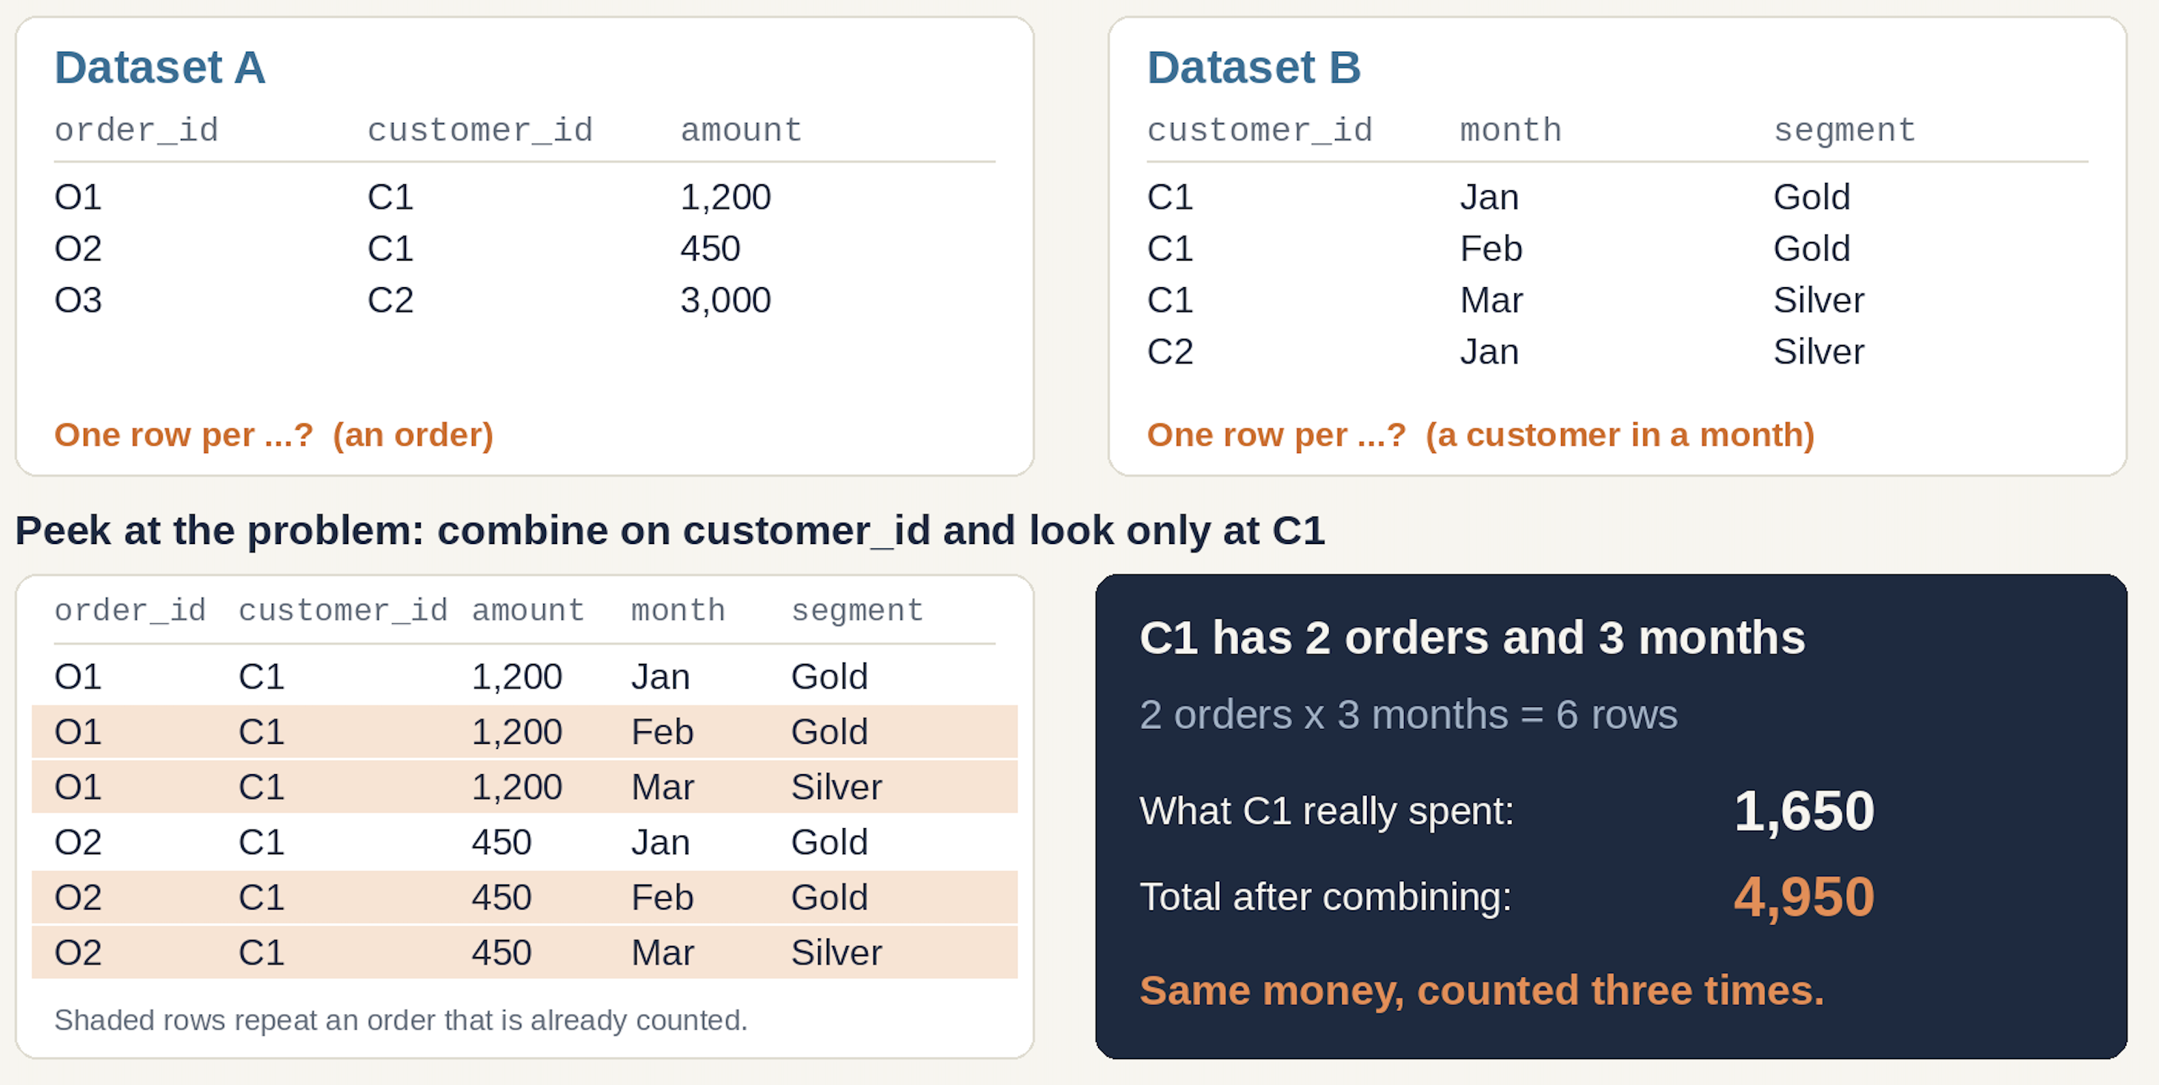
Can these two datasets be combined?
Dataset A
Dataset B
order_id, customer_id, amount
customer_id, month, segment
One row per ...?
One row per ...?
Do not join yet. Feel the problem first.
W01-S10 · Introduction to Data Science
Notes:
Guide W01-S10. Do not teach joins. Collect guesses about what could go wrong when the grain differs. Joins come in Week 10.

Slide 11
Beliefs to retire
You might think | Better
Data Science is Python | Python is a tool; Data Science is the reasoning
Data Science is Machine Learning | ML is one stage of the lifecycle
More data is always better | Quality, representativeness and relevance matter
A dataset is the truth | A dataset is a record someone made; question it
W01-S11 · Introduction to Data Science
Notes:
Guide W01-S11. Ask which belief each student held before today. Tally on the board and start Week 2 with the most common one.

Slide 12
Exit ticket
What is Data Science?
What is one misconception you had?
What are the first three questions you will ask about any new dataset?
Before Week 2: set up Google Colab and a GitHub account.
W01-S12 · Introduction to Data Science
Notes:
Guide W01-S12. Collect on paper or a form. Strong answers: what problem, where did the data come from, what does one row represent.

